Slide 1
Clofazimine in Mycobacterium Avium Complex (MAC) pulmonary disease

Slide 2
Background
The management of MAC lung disease can be complex and treatment outcomes are often poor.
The American Thoracic Society/Infectious Diseases Society of America guidelines recommend a three-drug macrolide combination therapy containing:
rifamycin (rifampin, rifapentine, or rifabutin)
ethambutol
macrolide (clarithromycin or azithromycin)
for at least 12 months after culture conversion.
The addition of aminoglycoside therapy (amikacin or streptomycin) is recommended in the first 3–6 months of therapy for severe disease.

Slide 3
Background
Treatment failure: re-emergence of multiple positive cultures or persistence of positive cultures
after ⩾ 12 months of antimycobacterial treatment
Refractory: MAC treatment > 6 months and culture remains positive
Relapse: successful treatment, defined as cessation of treatment and documented negative culture; however, return to positive culture less than 6 months after cessation

Slide 4
Background
Therapy is prolonged and expensive, and is frequently associated with drug-related adverse events.
Drug intolerance and drug-drug interactions are problematic and often limit the use of first-line medications.
Information on second-line agents, such as fluoroquinolones, inhaled amikacin, and clofazimine, is limited.

Slide 5
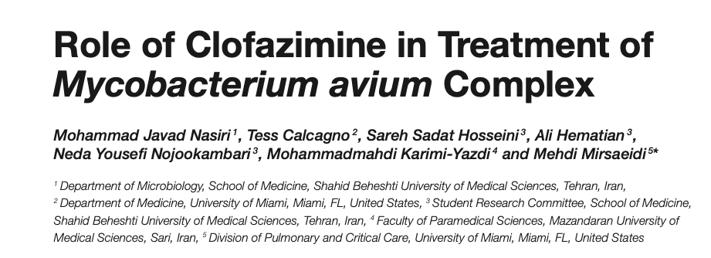
Clofazimine in MAC-PD

Slide 6
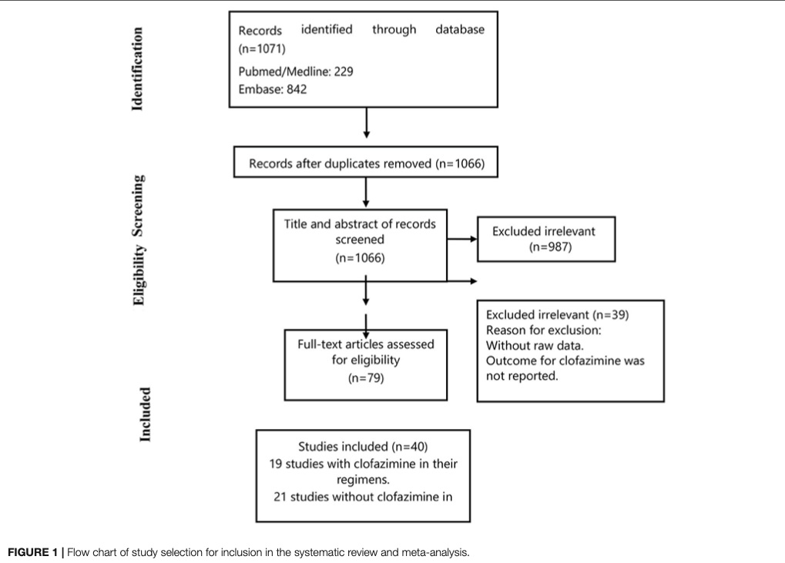
Clofazimine in MAC-PD

Slide 7
Clofazimine in MAC-PD
EY
Included studies met the following inclusion criteria:
patients were diagnosed with MAC using the criteria suggested by ATS/ IDSA;
all study patients were treated with clofazimine or macrolide and/or aminoglycoside-containing regimens, with companion drugs;
the treatment outcomes were addressed.
They defined treatment success as achievement of culture conversion and completion of the planned treatment without relapse while on treatment.

Slide 8
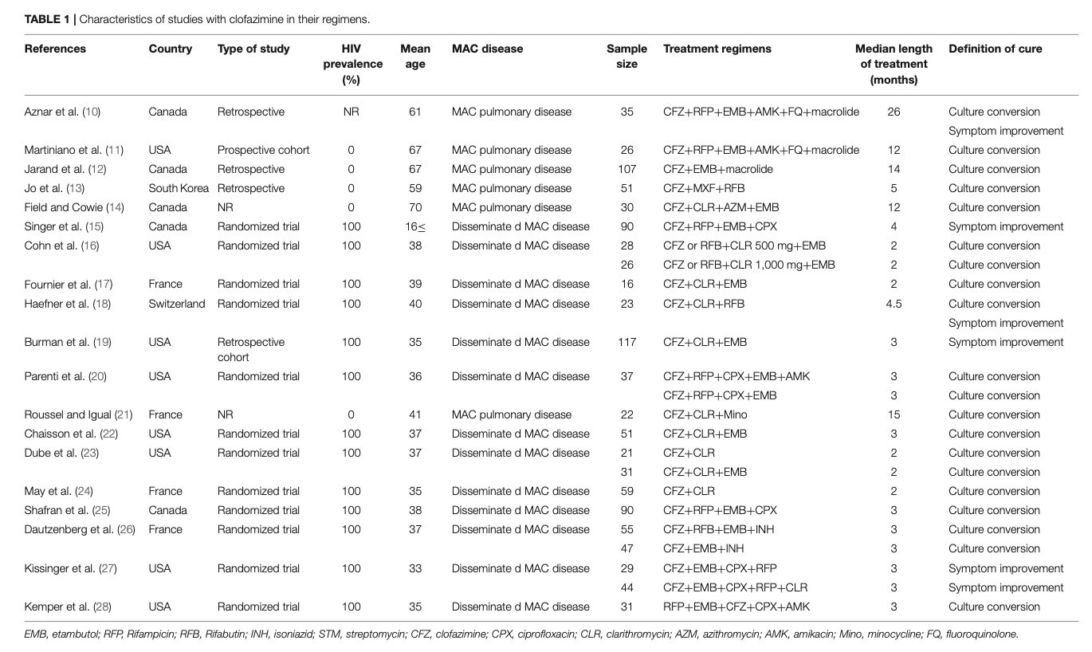
Characteristics of clofazimine group

Slide 9
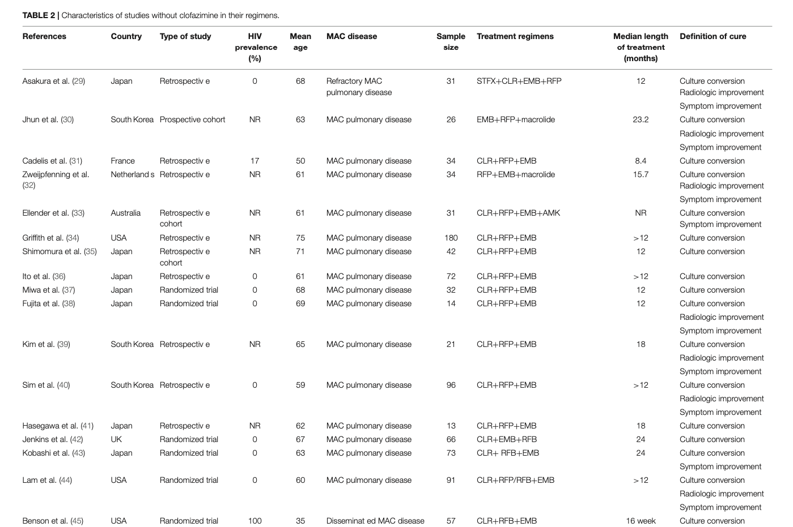
Characteristics of non-clofazimine group

Slide 10
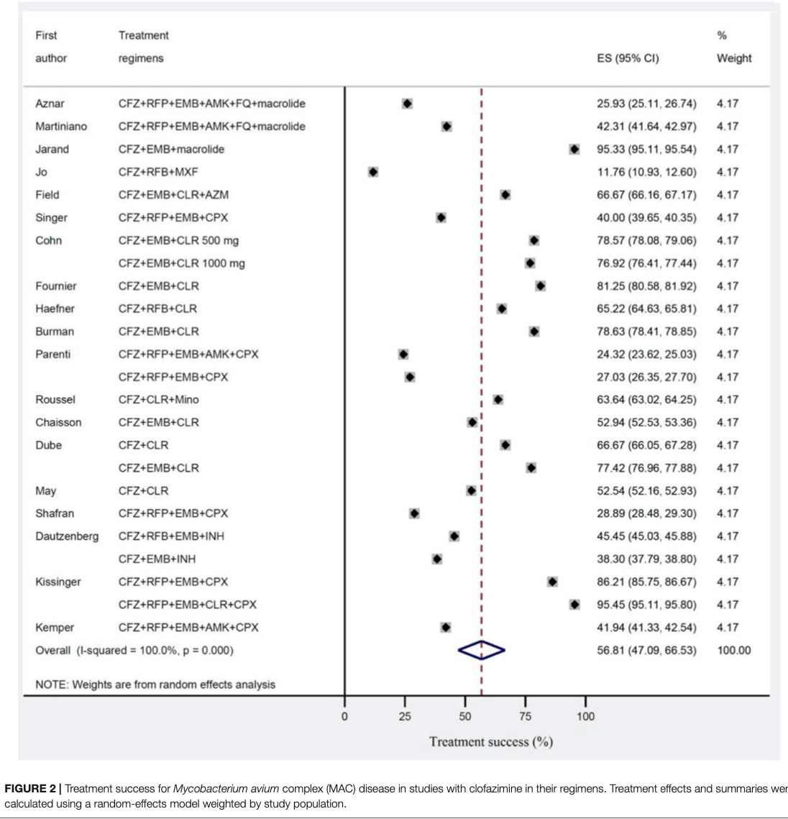
Treatment success for MAC disease in clofazimine group
Treatment success rates: 56.8%

Slide 11
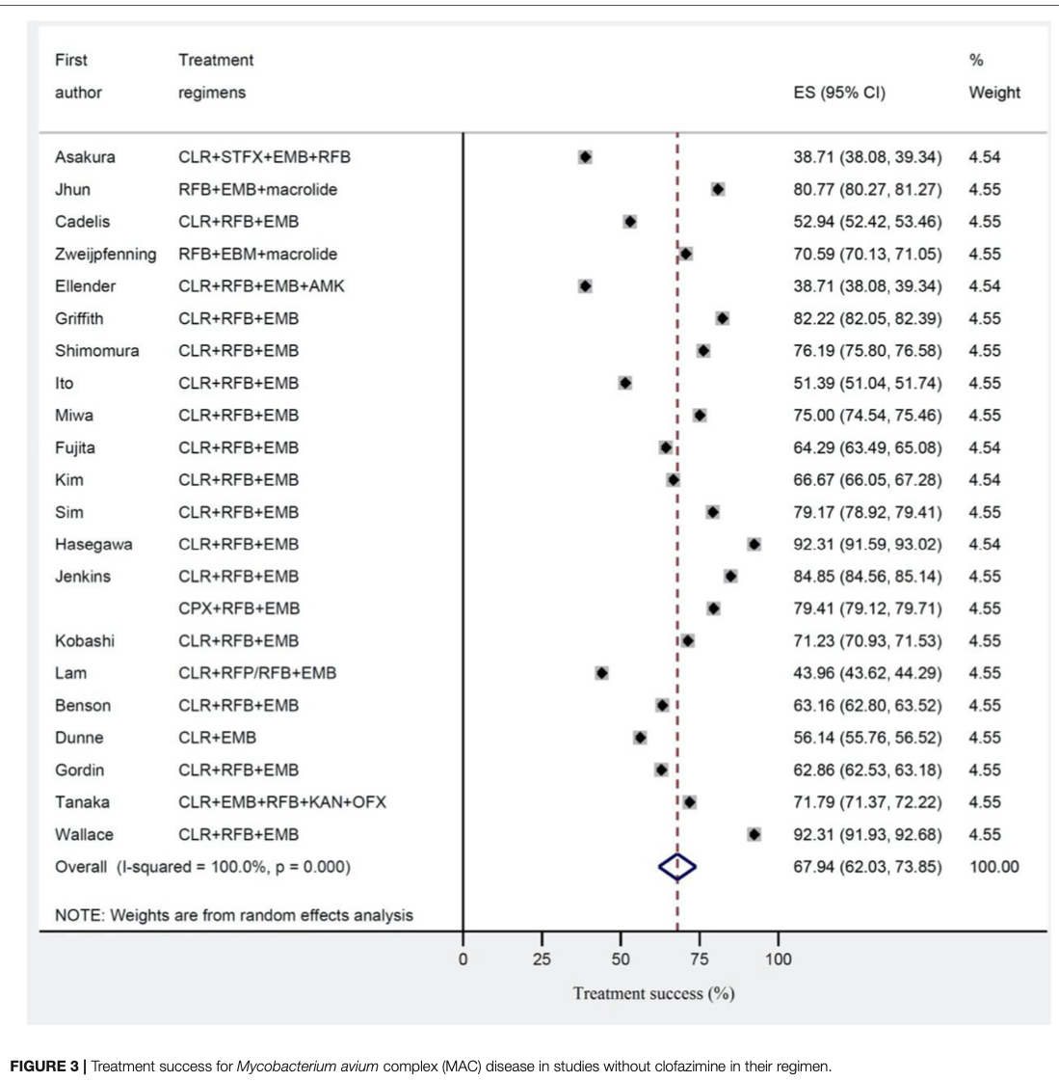
Treatment success for MAC disease in non-clofazimine group
Treatment success rates: 67.9%

Slide 12
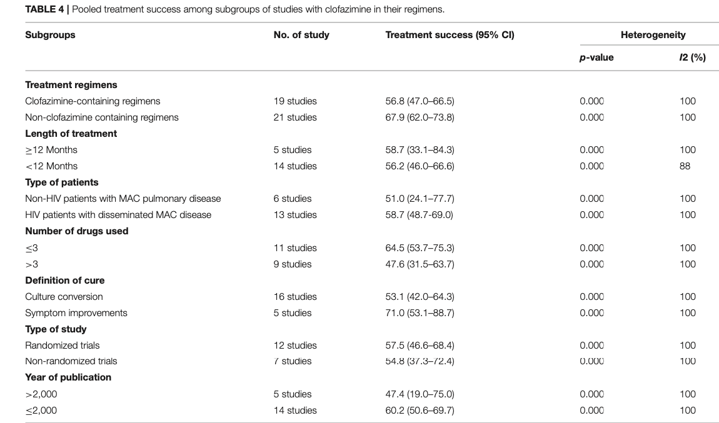
Subgroup Analysis

Slide 13
Limitations
The study did not characterize adverse effects and treatment adherence to clofazimine regimens
A significant source of heterogeneity in both clofazimine and non-clofazimine groups

Slide 14
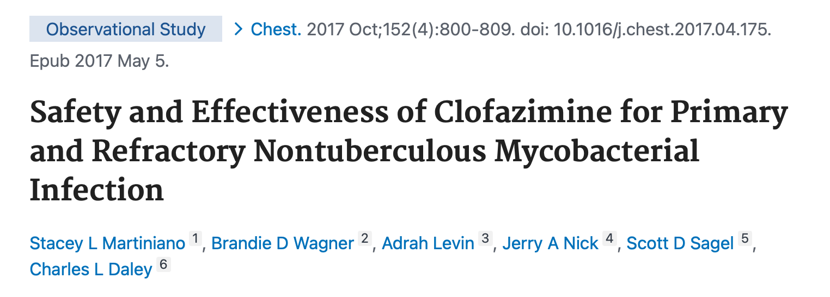
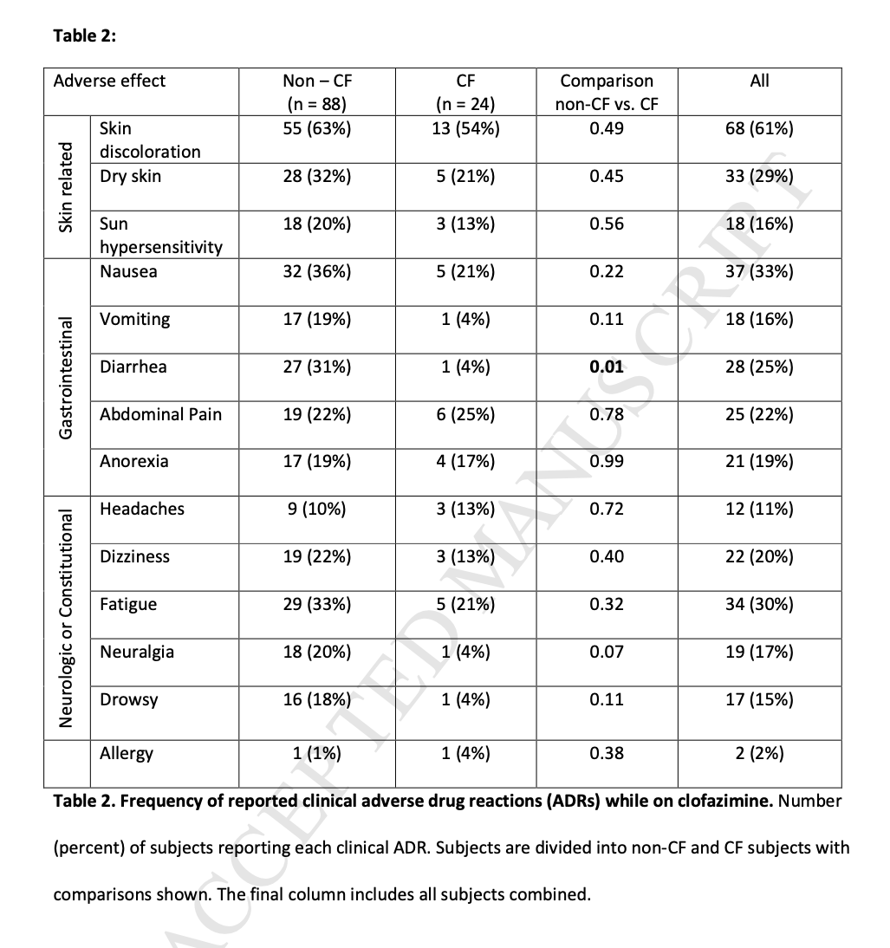
Side Effects

Slide 15
Future Directions
Should Clofazimine be considered a reasonable alternative for treatment of MAC lung disease?
Is it possible that its only role is in the treated of disseminated HIV disease?

Slide 16
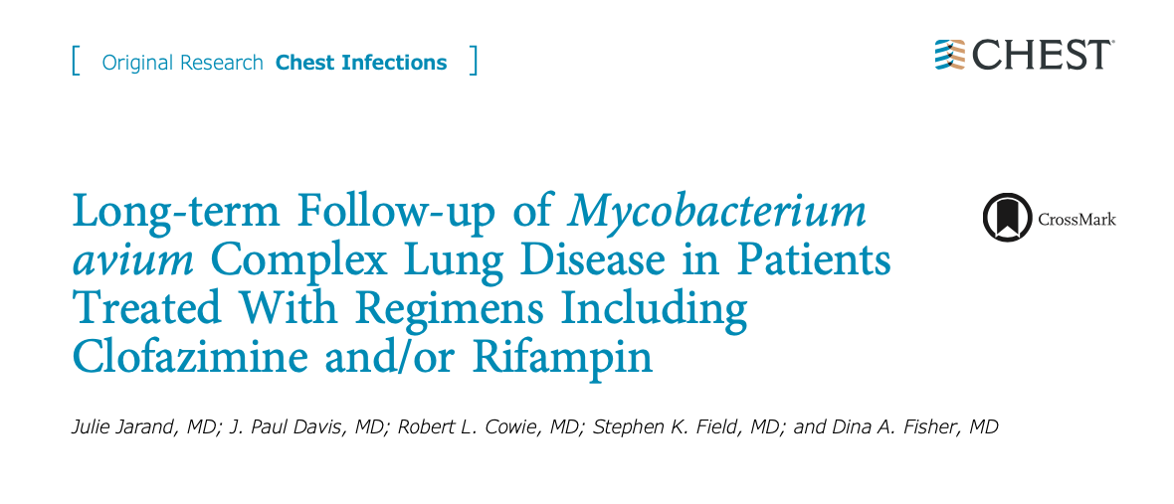
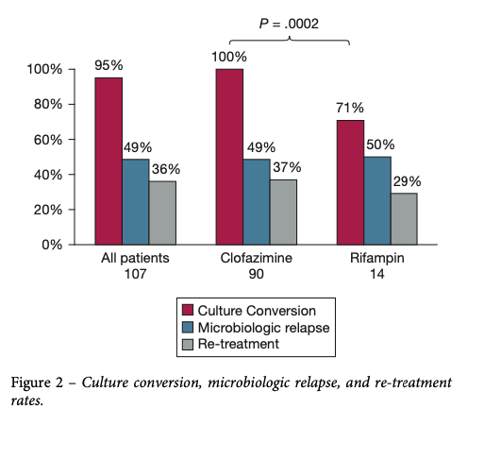
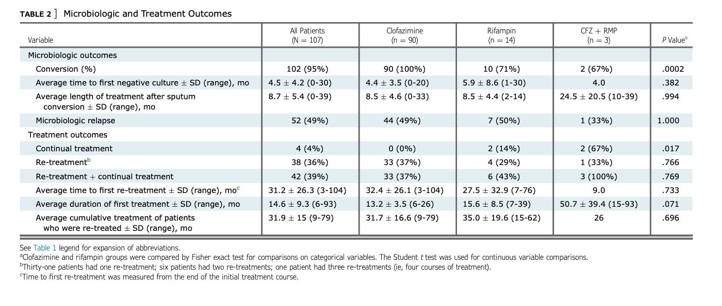
Clofazimine in MAC-PD

